Slide 1
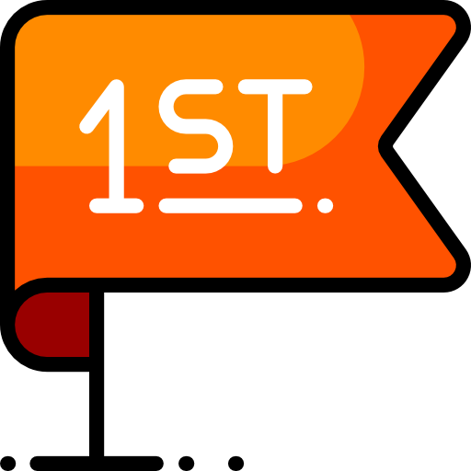
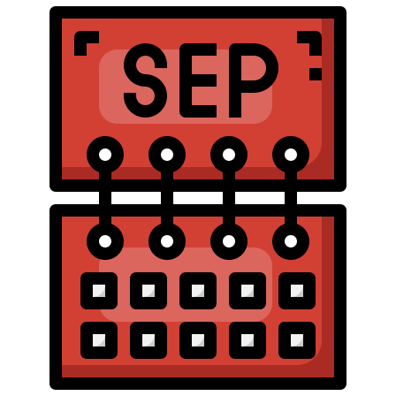
CompSci club
Intro to Computer Science & Python
Hello there! This is our first presentation of the year (WOO!!!)

Slide 2

Our person of the day!
Craig Federighi
Tomorrow, Apple will have their annual Apple Event
One of the conference’s most popular figures over the years has been Craig Federighi, the senior vice president of software engineering at the company
Craig received his degree from UC Berkeley and would work under Steve Jobs at NeXT
He would rejoin Apple in 2009 to lead their macOS engineering and would take on the iOS responsibilities three years later
Craig’s team is responsible for the interfaces, applications and frameworks Apple provides!
He would be present at numerous Apple events, dating back to 2009, but he would become famous for his appearance in 2020 — people have loved his energetic personality ever since!
Software Engineer at Apple

Slide 3
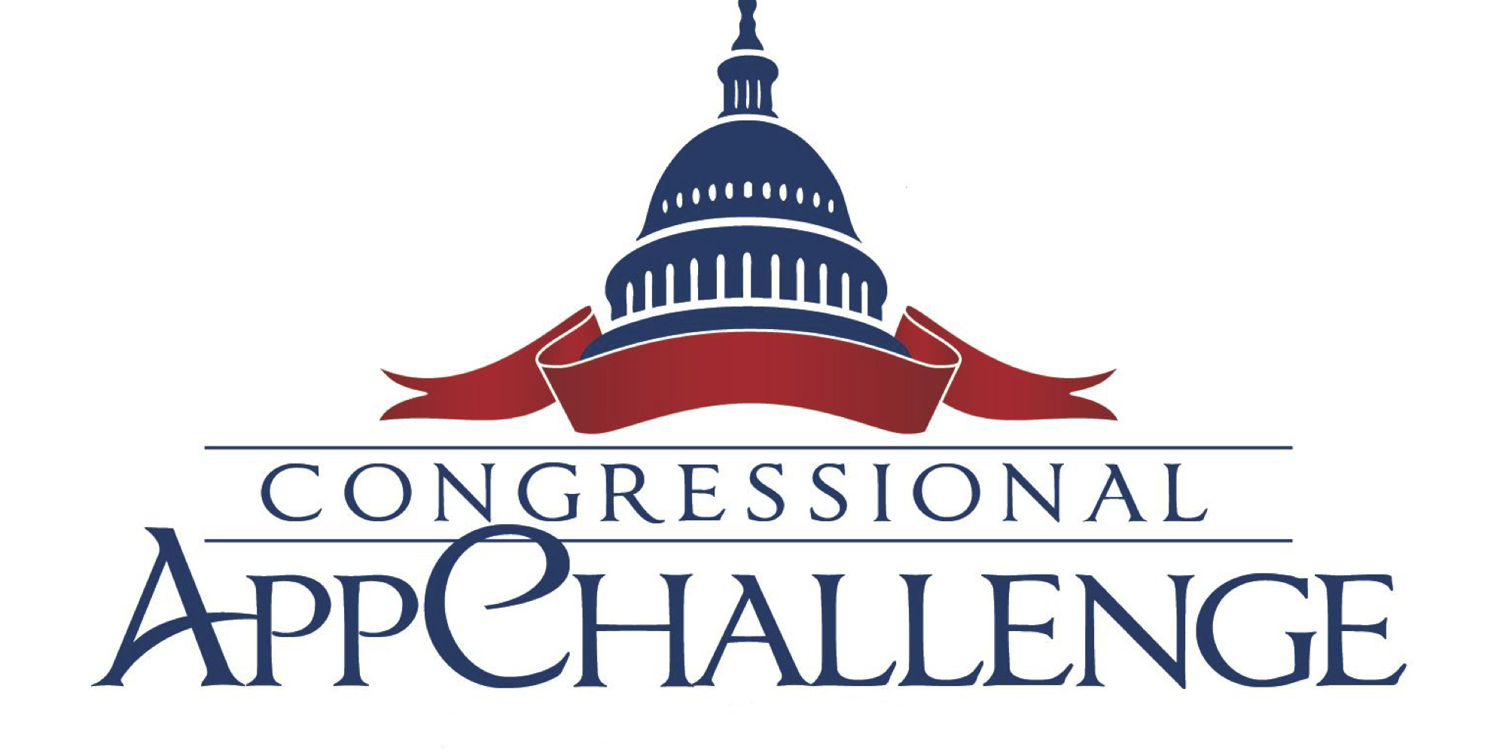
Opportunities Board
This is something that we will do periodically, or as frequently we get chances to show you things!
These are upcoming CS events or activities that we think you might enjoy — usually they will have something for all experience levels
Currently, the Congressional App Challenge is running, which is a fantastic opportunity to design and even build apps to display to the local community and even the entire U.S.!
No prior coding experience is required to participate and you can find resources for challenge in the speaker notes!
The deadline is October 1st!
Notes:
Some resources to help you!
https://ross.house.gov/services/congressional-app-challenge
https://www.congressionalappchallenge.us/students/rules/

Slide 4

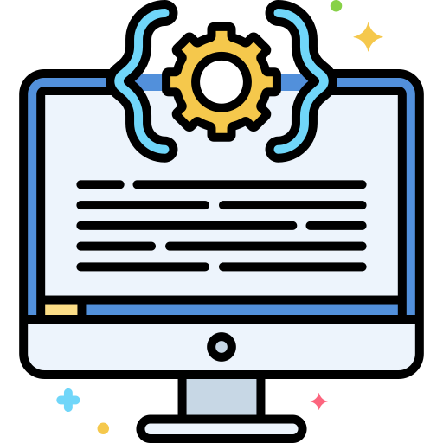
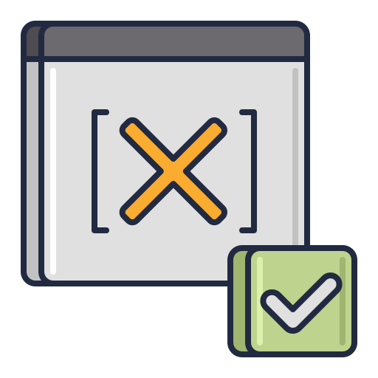
Roadmap for Today
What is Computer Science?
An quick overview of Computer Science and popular programming languages
Setting up our coding environment
In order for us to code, we need something to code on. Let’s gets introduced to that!
Variables and the Print Function
Let’s go over our very first Python fundamentals — variables and print function

Slide 5
Ooh, I know! Very fun :)
What is
Computer Science?

Slide 6
What is this Computer Science
If you search up Computer Science, you will get this boring definition from Google:
The study of the principles and use of computers.
Eh, not really that exciting. If it was up to me, I would definite computer science as…
USING COMPUTERS TO DO REALLY COOL THINGS THAT YOU CAN ACTUALLY USE
At the center of computer science is the software and software systems, which is what separates it from other computational fields like computer and electrical engineers
At the center of Computer Science are programming languages that power software, and by learning these languages, you can create nearly anything

Slide 7

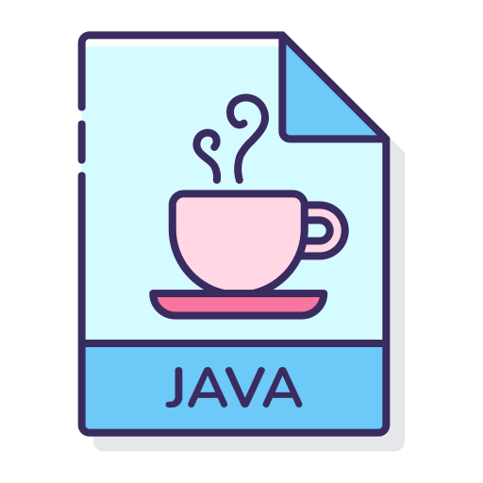

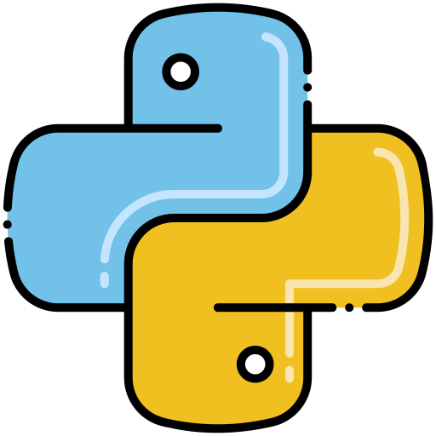
Examples of programming languages
Programming languages are kind of like the Romance languages — they all have the same underlying principles and ideas, but they each allow you to communicate with a different part of the world
Let’s take a look at some of the most popular languages:
C, C#, C++: Though all slightly different, C is a versatile, low level programming language that has been popular for decades
Java: Versatile, like C, but its specialties include web-based and other system applications. Also, yes, the language a version of Minecraft is coded in...
JavaScript: Technically a scripting language, JavaScript is embedded in nearly every single website on the internet. It’s the logic behind websites.
Python: An extremely popular programming language for its ease of use and numerous applications, Python can be used from web-development to machine learning.

Slide 8
Why Python?
print("This is a print statement!")
When Python’s founder, Guido van Rossum, created Python, he based it on these principles:
Beautiful is better than ugly
Explicit is better than implicit
Simple if better than complex
Complex is better than complicated
Readability counts
In other words, Python is a minimalistic, straightforward language that can do a lot
While Python can be picked up by beginners with relative ease, it is still powerful enough to be used extensively
The example on the right is an example of how to print in Python vs Java. Can you see the simplicity of Python?
public class Main {
public static void main(String[] args) {
System.out.println("Also a print statement!");
}
}
Notes:
More information about von rossum: https://developer-tech.com/news/2019/oct/31/farewell-benevolent-dictator-python-creator-guido-van-rossum-retires/

Slide 9
It’s in the cloud!
Setting up our
Coding environment

Slide 10
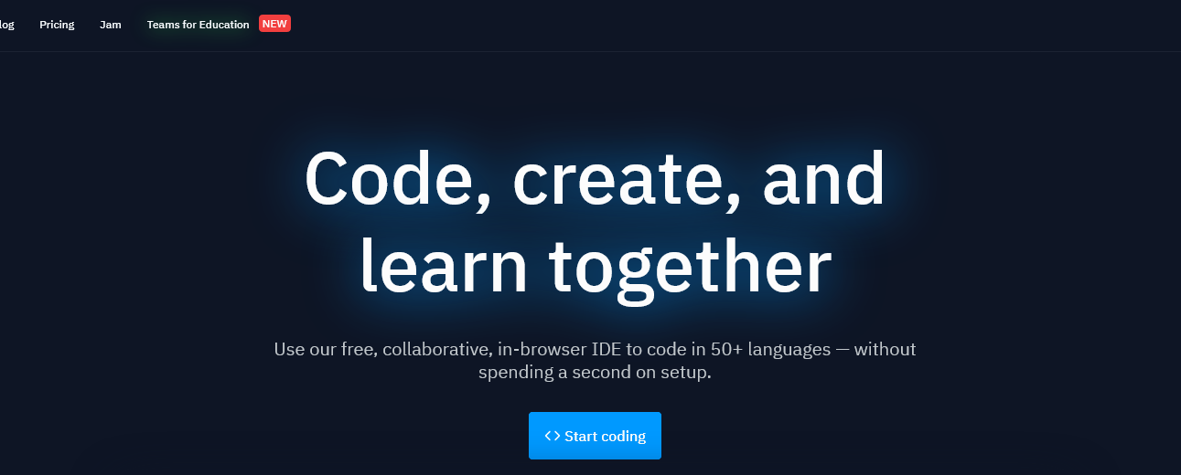
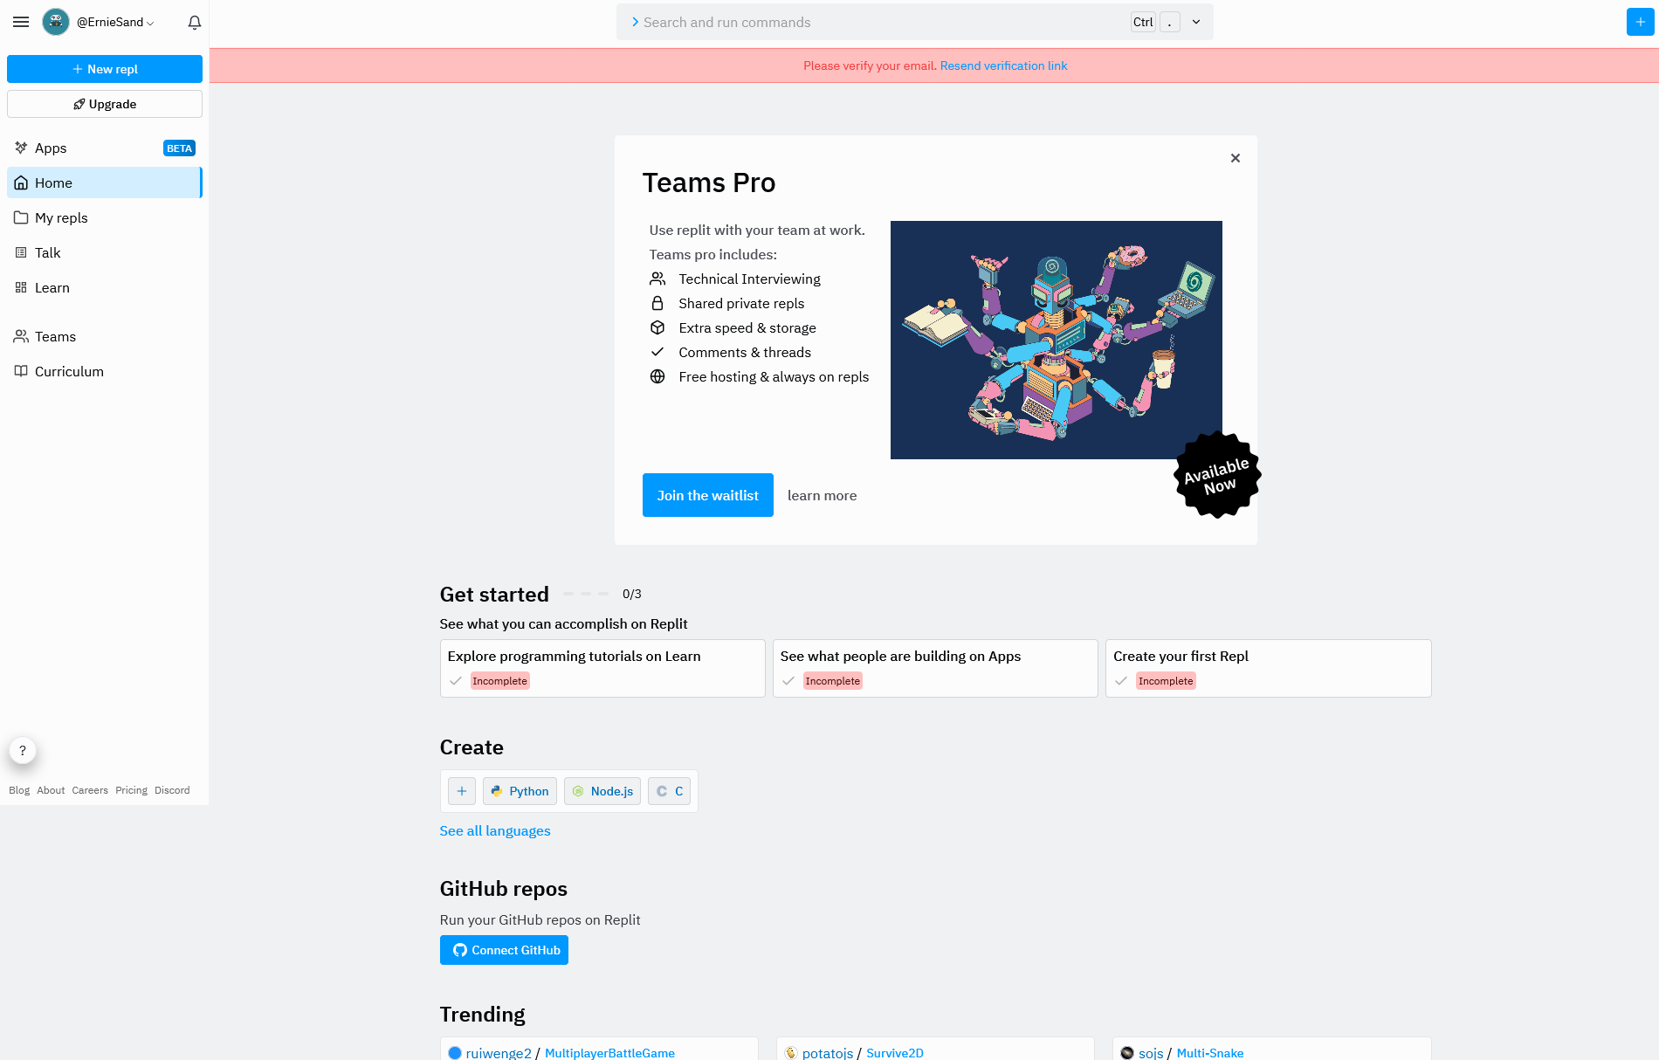
What will we be using to code?
To code, we will be using a Cloud Integrated Development Environment (IDE) called Repl.it
An IDE is an application that allows us to be able to write and execute our code all in one place instead of having to use a text editor and the terminal — in other words, it’s a one stop place to house all of our code!
Being in the cloud, we can access Repl.it from anywhere, including our Chromebooks!
Many of these cloud IDEs work like Google Apps and allow us to have multiple users edit a single file at the same time
To get started, go to https://www.Replit.com
Sign up using your Raleigh Charter Email Address

Slide 11
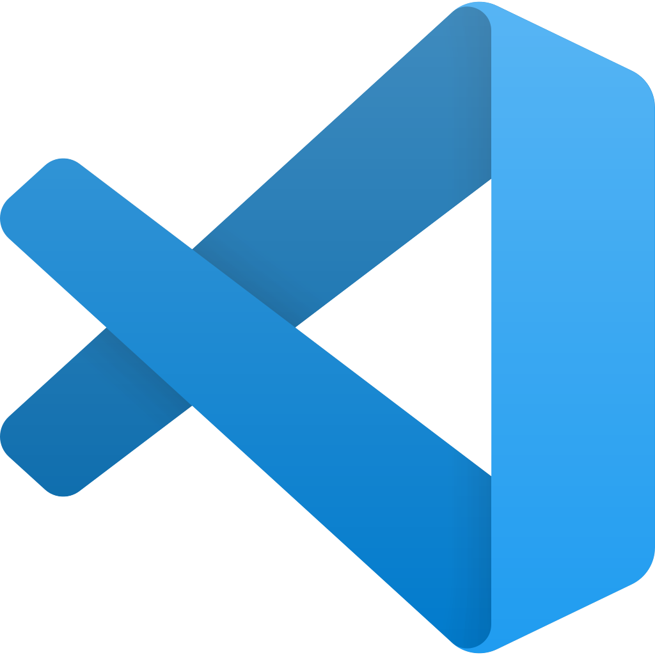
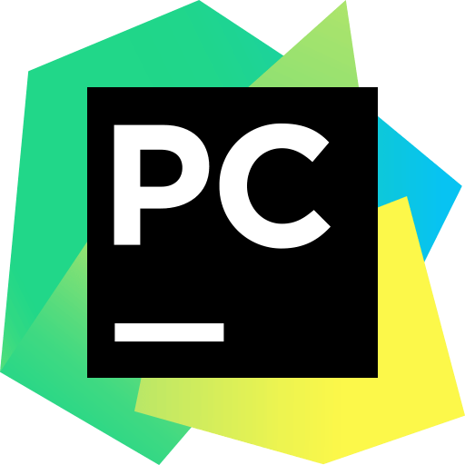
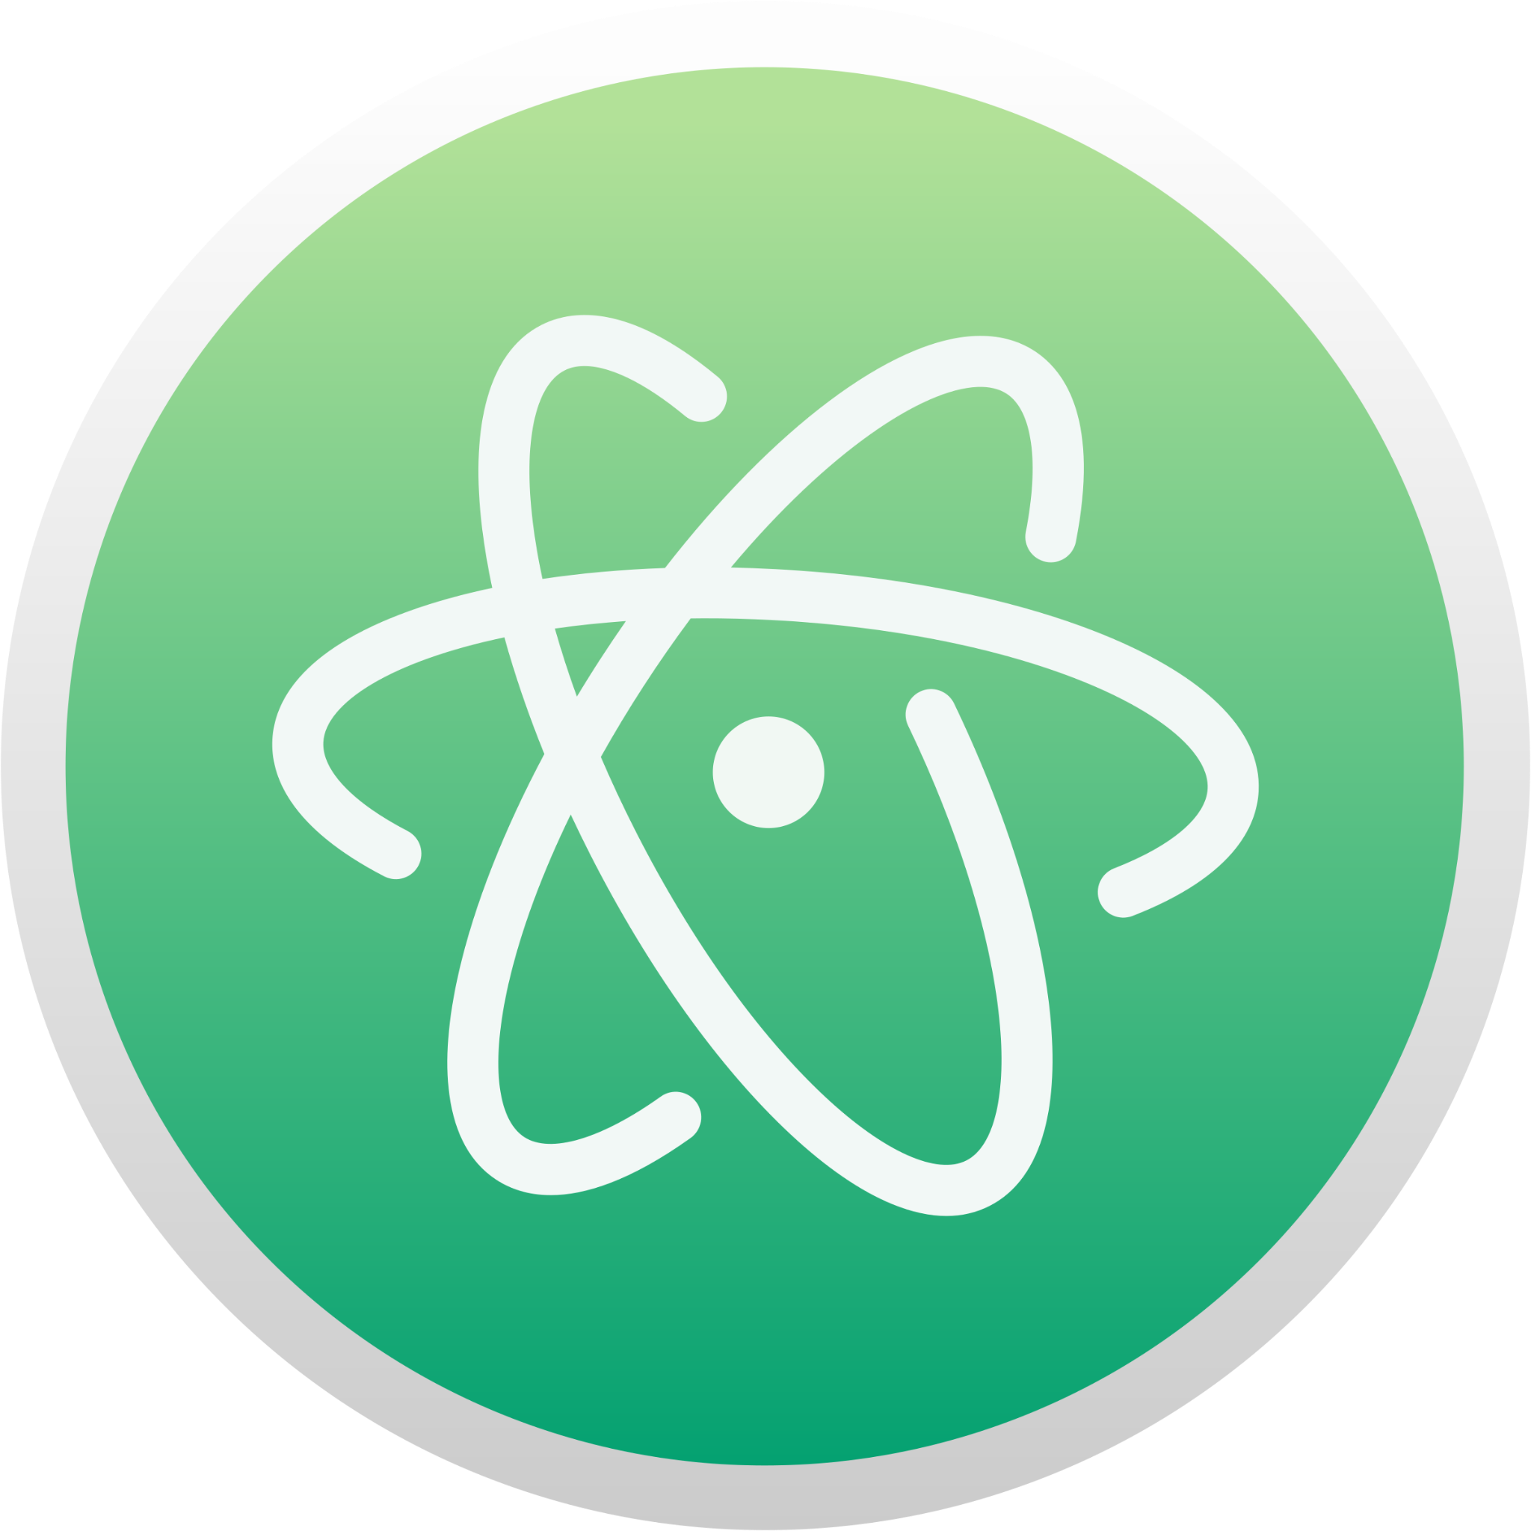
What else Can I use to code?
Visual Studio code
PyCharm
Atom
One of the most popular code editors in the world, VS Code allows users to code in a wide array of coding languages with the backing of Microsoft updates. There is even a compact web version now: vscode.dev.
A text editor built around using Python, PyCharm is developed by JetBrains and has a professional and free version. The professional version is free for students!
Produced by Github, Atom calls itself a “hackable text editor for the 21st Century,” priding itself on its customizability and packages.
Notes:
Note: Not all of these ides per say, but are text editors that have amazing syntax highlighting that makes coding much easier. When looking at ides, they are typically dependent upon the goal of the user (web development, robotics, etc…)

Slide 12
Woo!!! Our let’s look at some code!
Our first coding principle:
Variables & Print

Slide 13
Just like in math, variables are extremely important in coding
They hold values that we can assign and call on whenever we want
We can multiply variables, divide them, call them in functions, they are really important!
f(x) = 5x+20
f(x) = 5x+20

Slide 14
Let’s look at variables
cool_variable = "Hello!"
string_variable = "String!"
By using equal signs, we can assign variables different values
We will cover the different data types of Python very soon, but an example are strings, which we put in quotes
Strings are text in programming
Look at the example on the right of a string variable
num_1 = 4
num_2 = 7
print(4 + 7) #What will happen here?
Besides strings, we can also assign numbers to variables and then run operations on them
On the right, I have two variables that are assigned two different numbers
When I run the final line of code, what do you think is going to happen?
Notes:
Overview of variables in Python (a bit complex for now): https://www.programiz.com/python-programming/variables-constants-literals

Slide 15
The print function
print("This is a print statement!")
#We can also print out variables!
my_var = 21
print(my_var) #21
#Some operations with variables and print
print(my_var + 3) #24
The Print function is a commonly used function in Python that displays whatever you pass into it into the terminal or console window
We will cover what functions are later, but printing is incredibly useful for debugging, the process of finding, removing and fixing eros in code
For now, we will use print all of the time in order to display values in Python
But, here is some food for thought:
We might not always want to display values to a user. Can you think of an example where our code does something where we do not want to just display that?

Slide 16
Naming Conventions
print("This is a print statement!")
#We can also print out variables!
my_var = 21
print(my_var) #21
#Some operations with variables and print
print(my_var + 3) #24
The Print function is a commonly used function in Python that displays whatever you pass into it into the terminal or console window
We will cover what functions are later, but printing is incredibly useful for debugging, the process of finding, removing and fixing eros in code
For now, we will use print all of the time in order to display values in Python
But, here is some food for thought:
We might not always want to display values to a user. Can you think of an example where our code does something where we do not want to just display that?

Slide 17
Bonus: Practice!
chemistry = "Study for quiz!"
calculus = "Derivative Homework"
print(chemistry)
print(calculus)
Class To-Do List Exercise:
Create 6 variables, one for every class you have
In each of those variables, assign what you have for homework
Use the print function to print out each of those variables to remind what you have to do for homework!
Think: What seems tedious about this?
num_1 = 9
num_2 = 13
print(num1 * num2)
print(num1 - num2)
Very Basic Calculator:
As we so earlier, variables in coding are very similar to the ones in math
Use the plus (+), minus (-), multiplication (*) and division (/) signs to do math in Python
Variable best practice: You can’t make variable names numbers. Make variables descriptive!

Slide 18
If you have any questions at all, please don’t hesitate to stay back or email one of us!
Thank you!
That is all we have for today!

